Slide 1
Predicting Myer-Briggs Personality
Group 4: Presentation Date: May 4th, 2021
Tina Hu whu7@horizon.csueastbay.edu
XiaoDong Nie nxiaodong@horizon.csueastbay.edu
Glee Truong gtruong5@horizon.csueastbay.edu
Dorbens Jean-Pierre djeanpierre@horizon.csueastbay.edu Austin Lim slim31@horizon.csueastbay.edu

Slide 2
What is the Myer Briggs Type Indicator(MBTI)
-Self-report questionnaire created by Isabel Myers and Katherine Briggs.
-Helps individual better understand their strengths,weaknesses, preferences, and
overall personality.
- 16 different personality types ( 8 introvert & extrovert types)

Slide 3
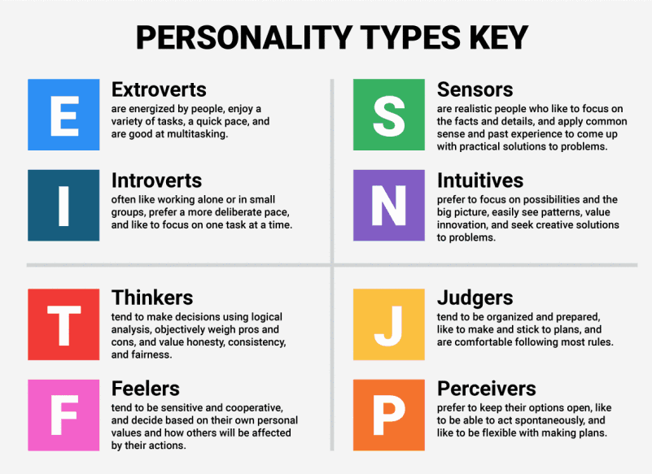

Slide 4
Data & Data Goal
-Collected Myer Briggs data from Kaggle
-8675 Individuals
-Each Individuals known personality types and what they post
- Use this data to run against how an individual describes themselves to assume the best fit MBTI type for them

Slide 5


Project Utilization
-Self-Improvement
-Job/Career Fulfillment
-and…..

Slide 6
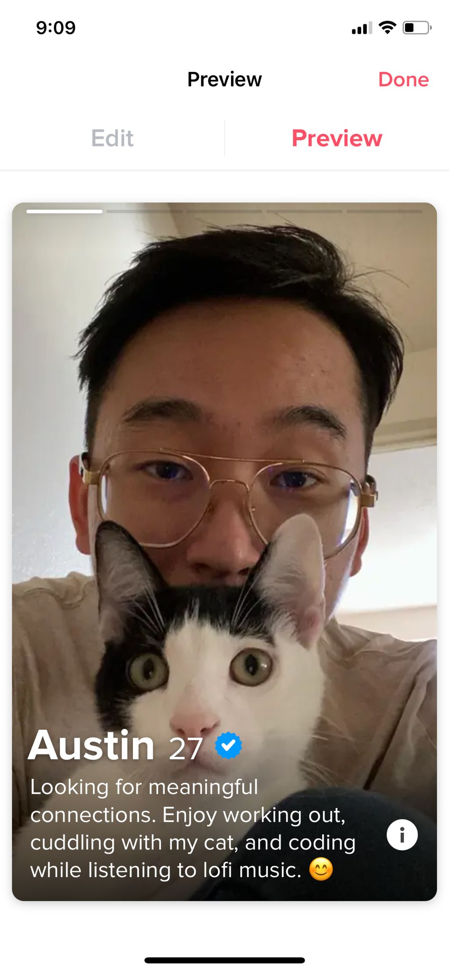



-Dating/LinkedIn
(based on the individuals “About me” bio and answered questions on profile)

Slide 7

Preprocessing
1. Individual user post as input text
2. Remove URL, delimiters (|||), numbers.
3. Convert emoticons (^_^)
to words
4. Lower words, tokenize words
6. Lemmatize words
WordNetLemmatizer()
6. Return final tokenized words list
7. Remove punctuation
5. Remove stop words

Slide 8
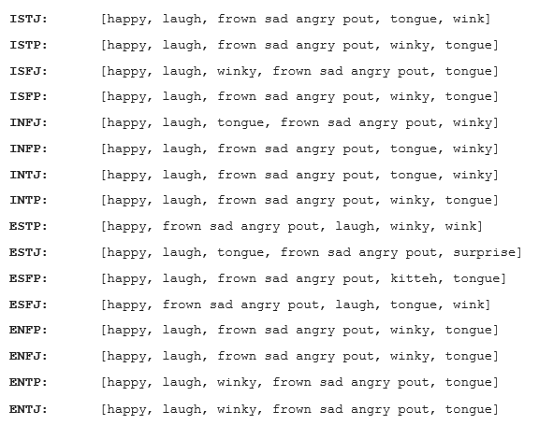
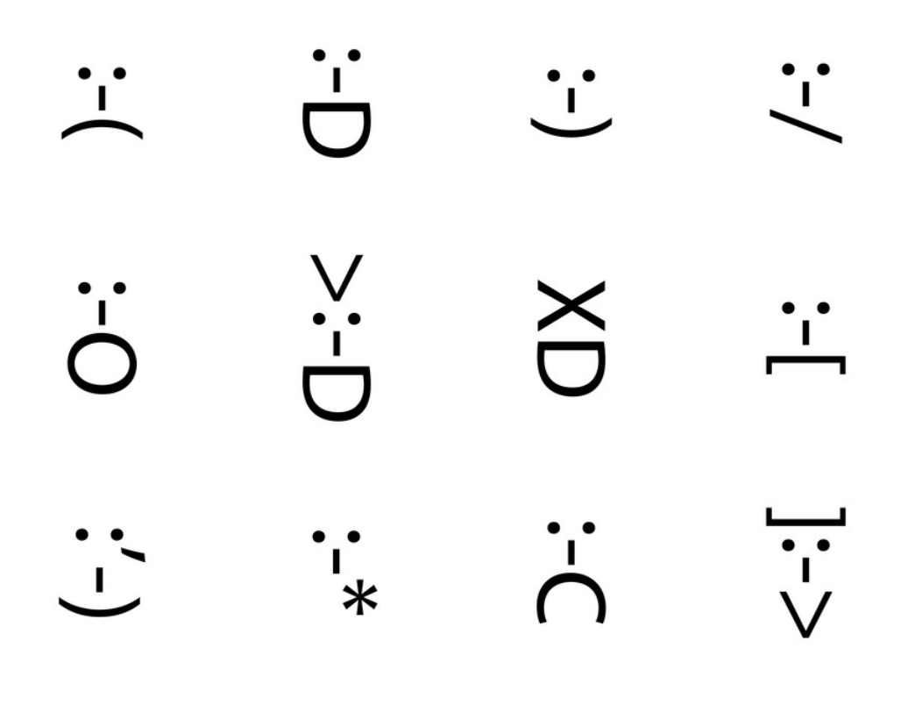
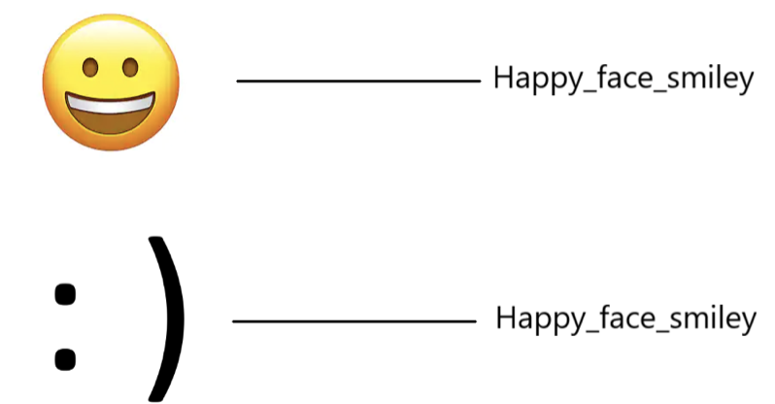
Emoticons

Slide 9
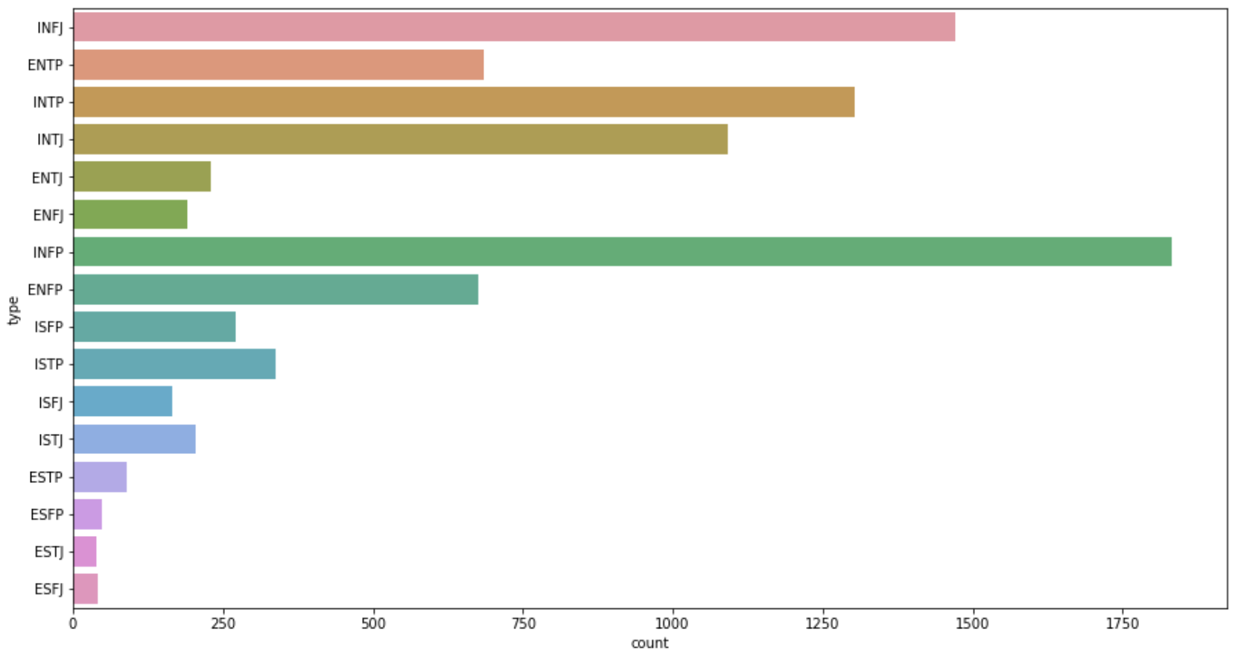
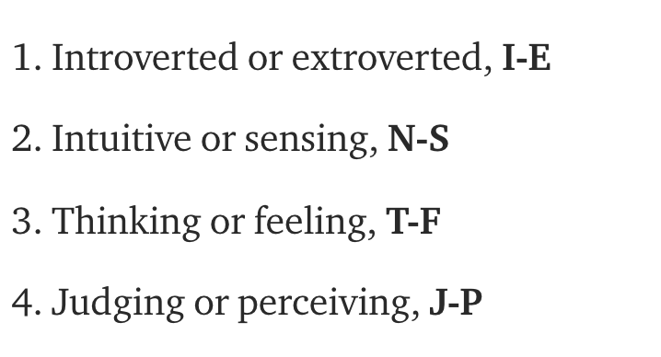
Skewness
myerType

Slide 10
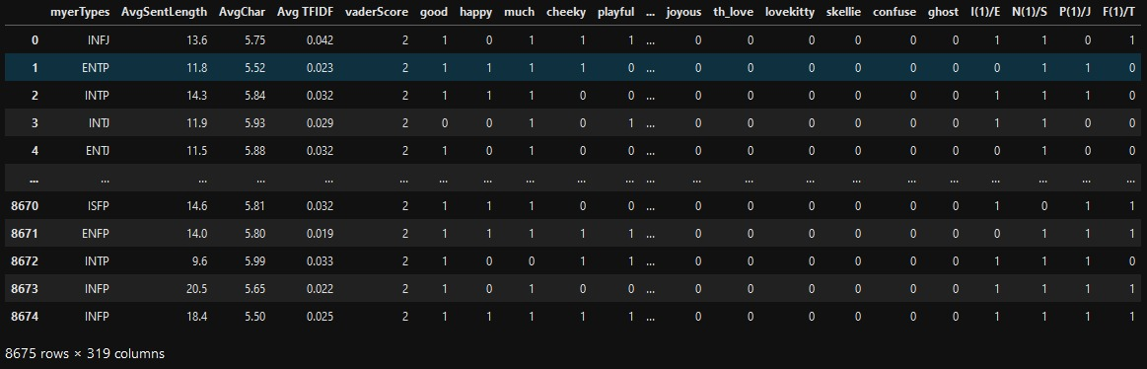
Features Set

Slide 11
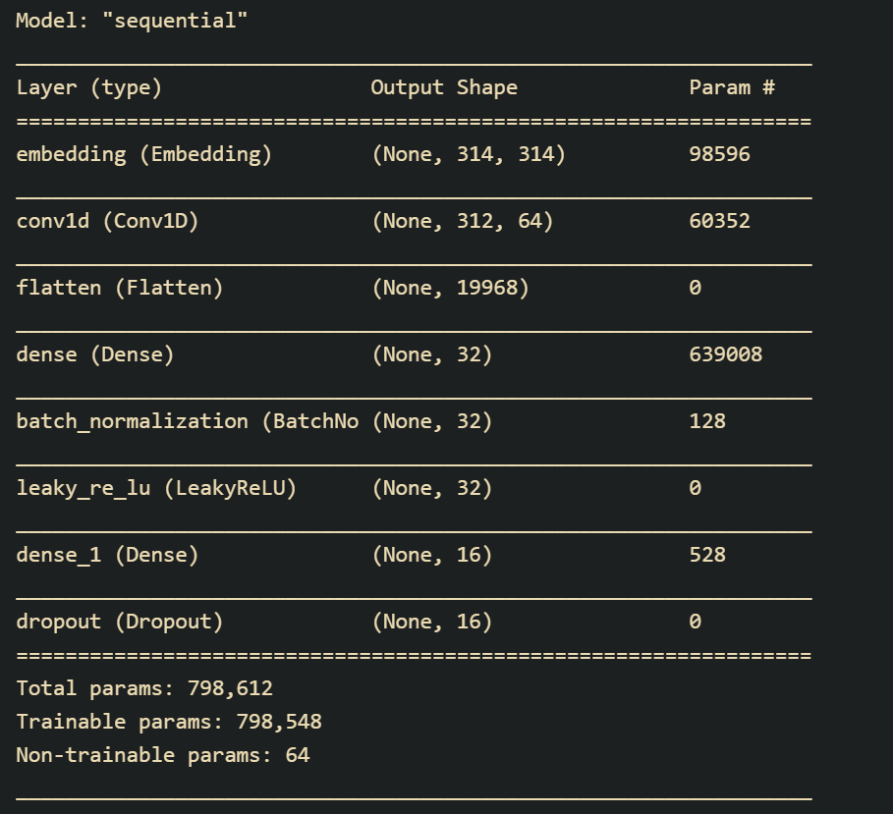
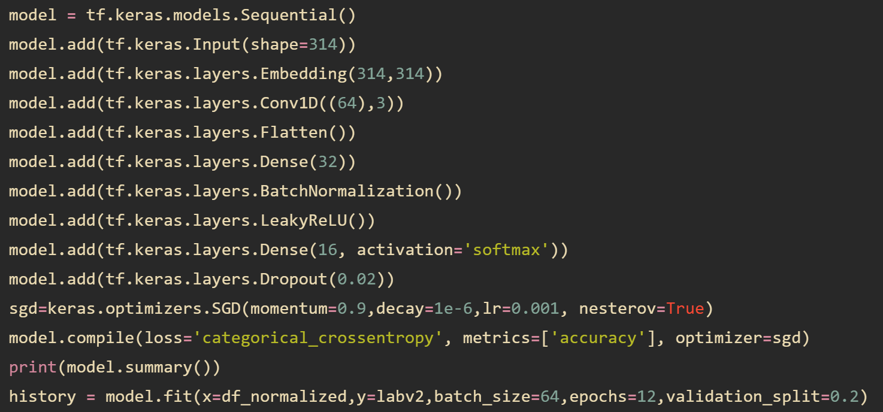
Neural Network Model: Myer Briggs (4 Letters)

Slide 12
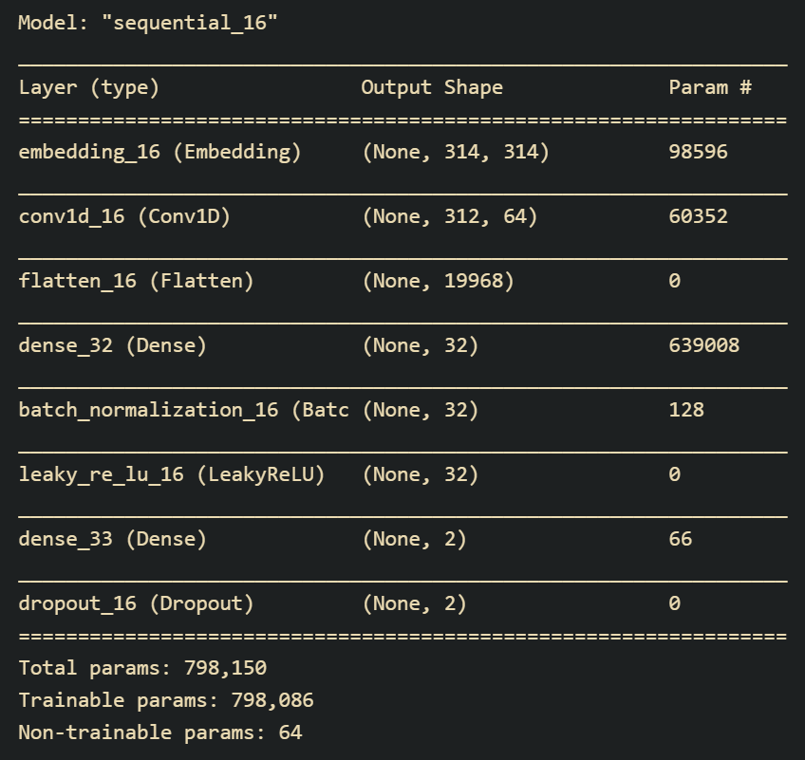
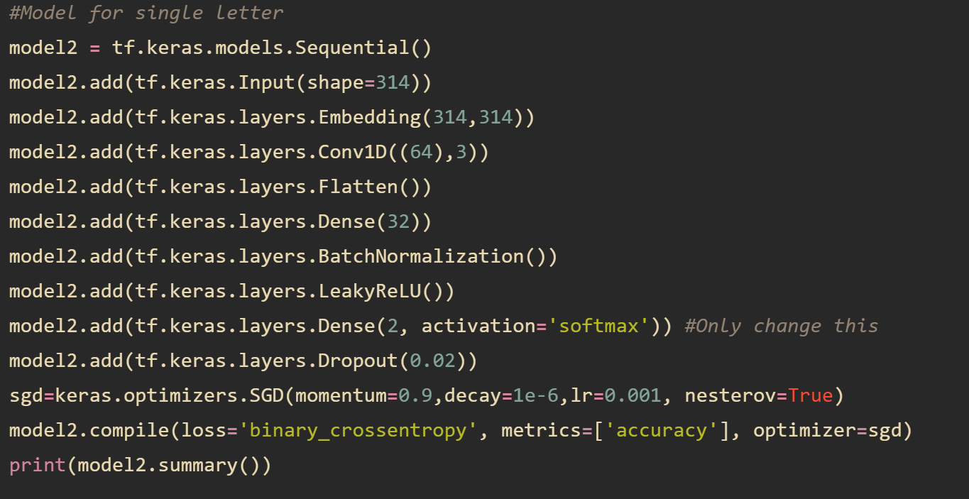
Neural Network Model: Single Letter (I/E, N/S, T/F, and P/J)

Slide 13
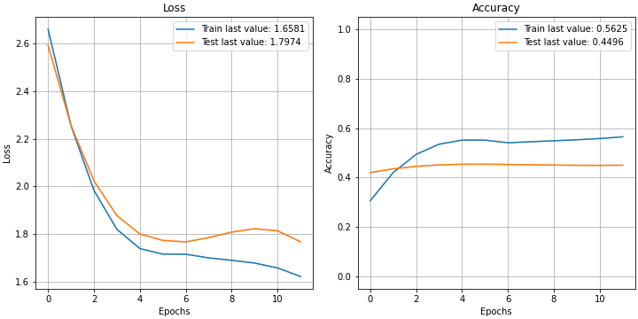
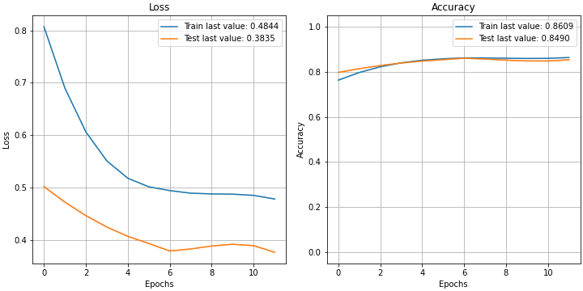
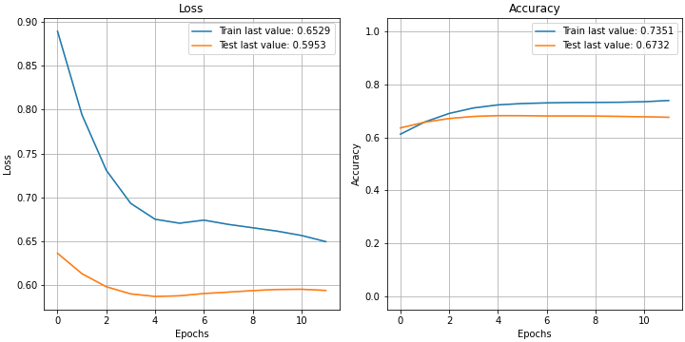
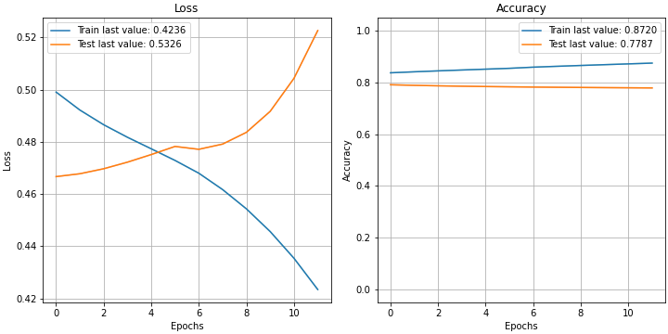
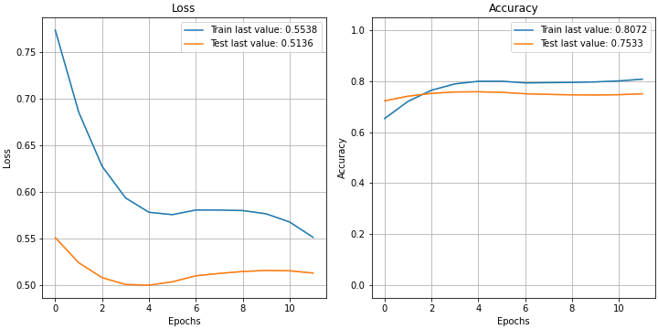
Results:
Myer Briggs:
I(N)tuitive / Sensing:
Perception/Judgement:
Introvert / Extrovert:
Thinking / Feeling

Slide 14
NN Summary:
Model | Training Accuracy | Valid Accuracy | Accuracy Benchmark | Above Benchmark
Myer Briggs (4 letters) | 0.5625 | 0.4496 | 0.0625 | Yes
I or E | 0.8720 | 0.7787 | 0.5000 | Yes
N or S | 0.8609 | 0.8490 | 0.5000 | Yes
T or F | 0.8072 | 0.7533 | 0.5000 | Yes
P or J | 0.7351 | 0.6732 | 0.5000 | Yes

Slide 15
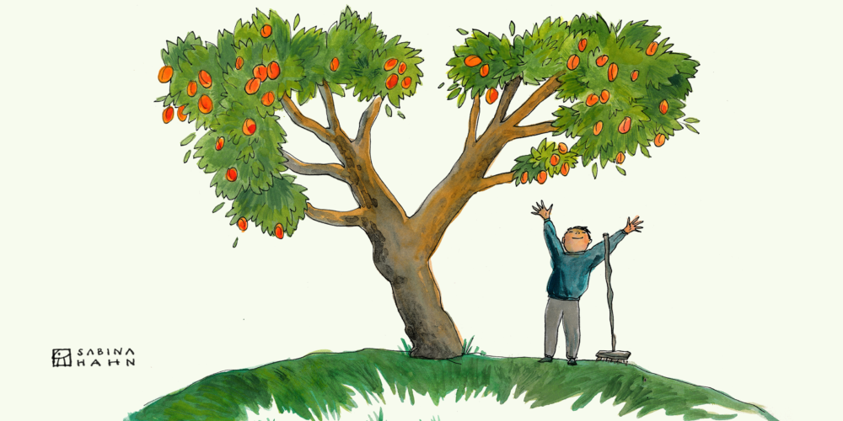
Decision Tree
Predictive Model
Classification Tree
Personality Class

Slide 16

Decision Tree Model
Model | Accuracy | Precision | Recall | F1
Myer Type | 0.1452 | 0.1472 | 0.1452 | 0.1461
I/E | 0.6484 | 0.7670 | 0.7658 | 0.7664
N/S | 0.7504 | 0.8730 | 0.8343 | 0.8532
P/J | 0.5077 | 0.5986 | 0.5850 | 0.5917
F/T | 0.5342 | 0.5681 | 0.5620 | 0.5651

Slide 17
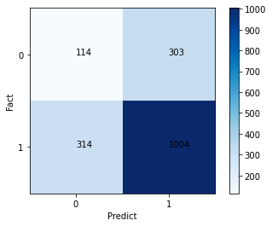
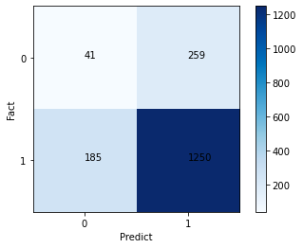
Confusion Matrix
Introverted(1)/Extroverted(0)
I(N)tuitive(1)/Sensing(0)

Slide 18
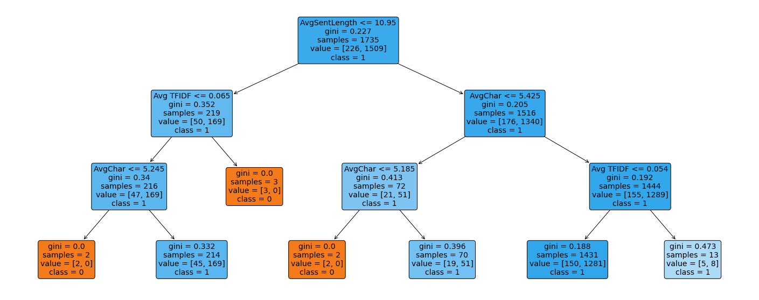
Decision Tree(N/S)

Slide 19
SVM - Radial Base Function
Models SVM(rbf) | Training Accuracy | Valid Accuracy | Null Accuracy | Precision | Recall
Myer Types | 0.8124 | 0.4674
I or E | 0.9072 | 0.7654 | 0.7533 | I(0.77) / E(0.69) | I(0.99) / E(0.09)
N or S | 0.8729 | 0.8697 | 0.8697 | N(0.87)/S(0) BIAS | N(1) / S(0) BIAS
P or J | 0.9144 | 0.6928 | 0.6098 | P(0.71) / J(0.65) | P(0.84) / J(0.46)
F or T | 0.9323 | 0.7804 | 0.5383 | F(0.79) / T(0.77) | F(0.81) / T(0.74)

Slide 20
SVM - Sigmoid
Models SVM(sigmoid) | Training Accuracy | Valid Accuracy | Null Accuracy | Precision | Recall
Myer Types | 0.4818 | 0.4703
I or E | 0.7728 | 0.7677 | 0.7533 | I(0.79) / E(0.58) | I(0.95) / E(0.22)
N or S | 0.8588 | 0.8692 | 0.8697 | N(0.87) / S(0) BIAS | N(1) / S(0) BIAS
P or J | 0.6661 | 0.6893 | 0.6098 | P(0.72) / J(0.62) | P(0.79) / J(0.52)
F or T | 0.7406 | 0.7620 | 0.5383 | F(0.78) / T(0.74) | F(0.78) / T(0.74)

Slide 21
Conclusion of 3 models
Validation Accuracy | NN | Decision Tree | SVM | Best Model
Myer Types | 0.4496 | 0.1452 | 0.4703 | SVM
I/E | 0.7787 | 0.6484 | 0.7677 | NN/SVM
N/S | 0.8490 | 0.7504 | 0.8692 | NN
P/J | 0.6732 | 0.5077 | 0.6893 | NN/SVM
F/T | 0.7533 | 0.5342 | 0.7620 | NN/SVM

Slide 22
Questions???

